Slide 1
Task 3.1 Report
Name: Abhishek Shashikant Chaphekar
Vulnerability Name: Reflected Cross Side Scripting
Ethical Hacking Internship

Slide 2
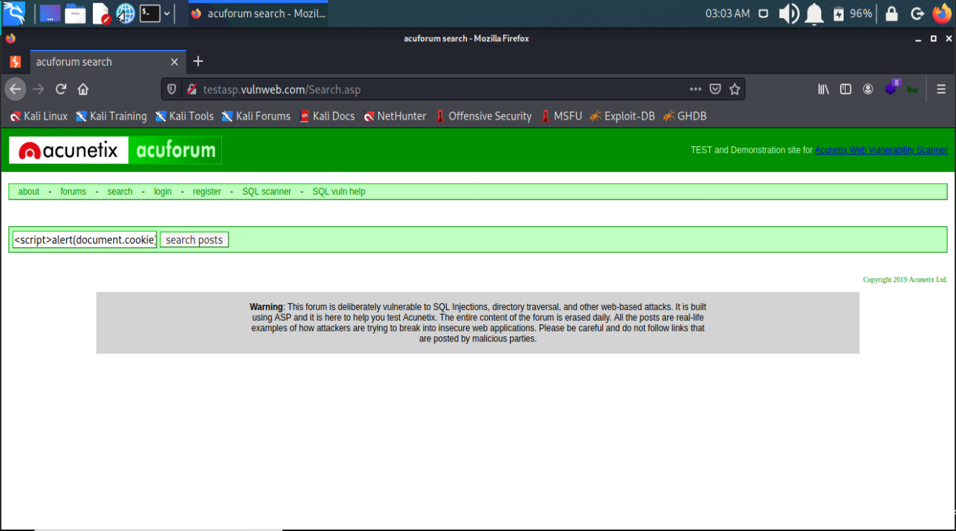
Screenshot 1

Slide 3
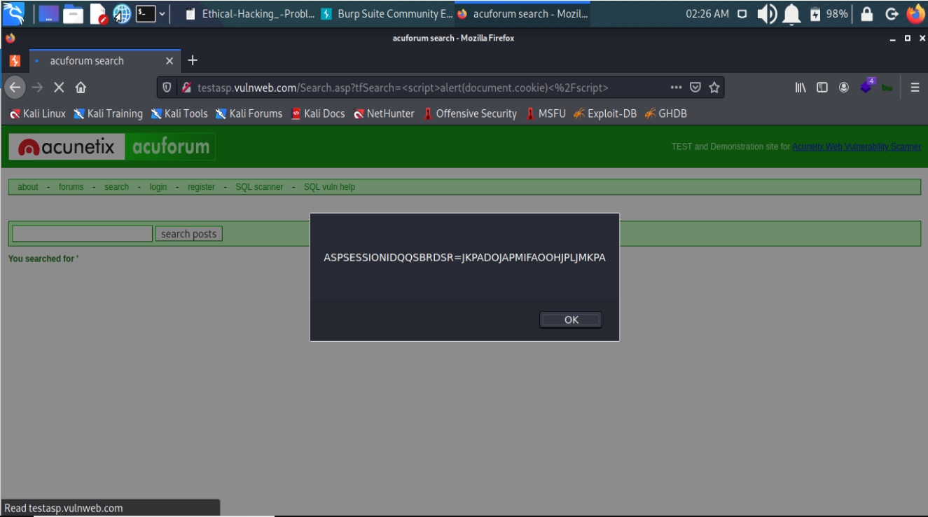
Screenshot 2

Slide 4
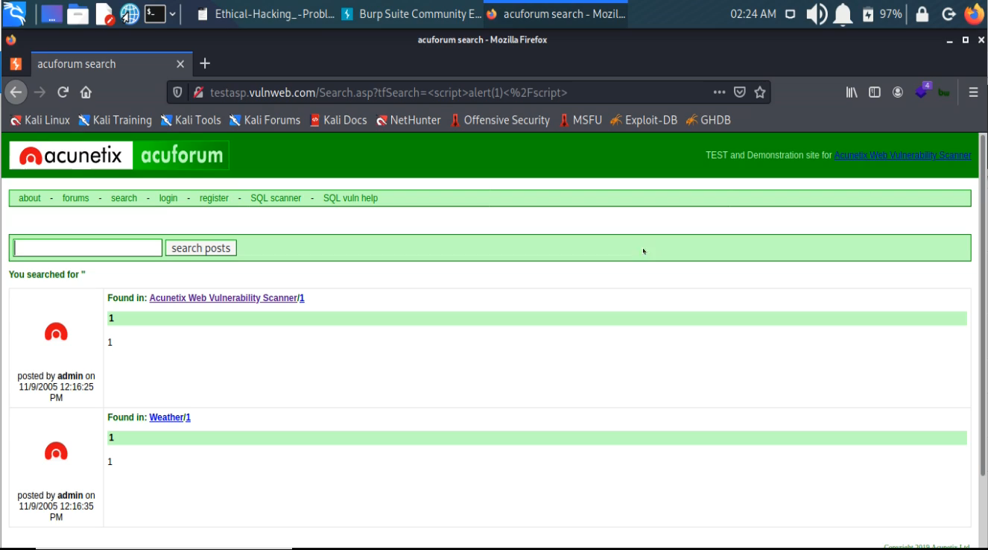
POC Video

Slide 5
Vulnerability Name: Reflected Cross Side Scripting
URL: http://testasp.vulnweb.com/
Severity: Critical
Reported By: Abhishek Shashikant Chaphekar
Reported On: 17/07/2021
Description:
Cross-site scripting (also known as XSS) is a web security vulnerability that allows an attacker to compromise the interactions that users have with a vulnerable application.
Cross-site scripting works by manipulating a vulnerable web site so that it returns malicious JavaScript to users. When the malicious code executes inside a victim's browser, the attacker can fully compromise their interaction with the application.
Reflected cross-site scripting (or XSS) arises when an application receives data in an HTTP request and includes that data within the immediate response in an unsafe way.

Slide 6
Steps to Reproduce:
1) Click on search tab
2) Inject following payload in search box: <script>alert(document.cookie)</script>
3) Click on search
5) Alert occurred
Impact:
If an attacker can control a script that is executed in the victim's browser, then they can typically fully compromise that user. Amongst other things, the attacker can:
Perform any action within the application that the user can perform.
View any information that the user is able to view.
Modify any information that the user is able to modify.
Initiate interactions with other application users, including malicious attacks, that will appear to originate from the initial victim user.
Solution:
Cross-site scripting prevention can generally be achieved via two layers of defense:
Encode data on output
Validate input on arrival

